Slide 1
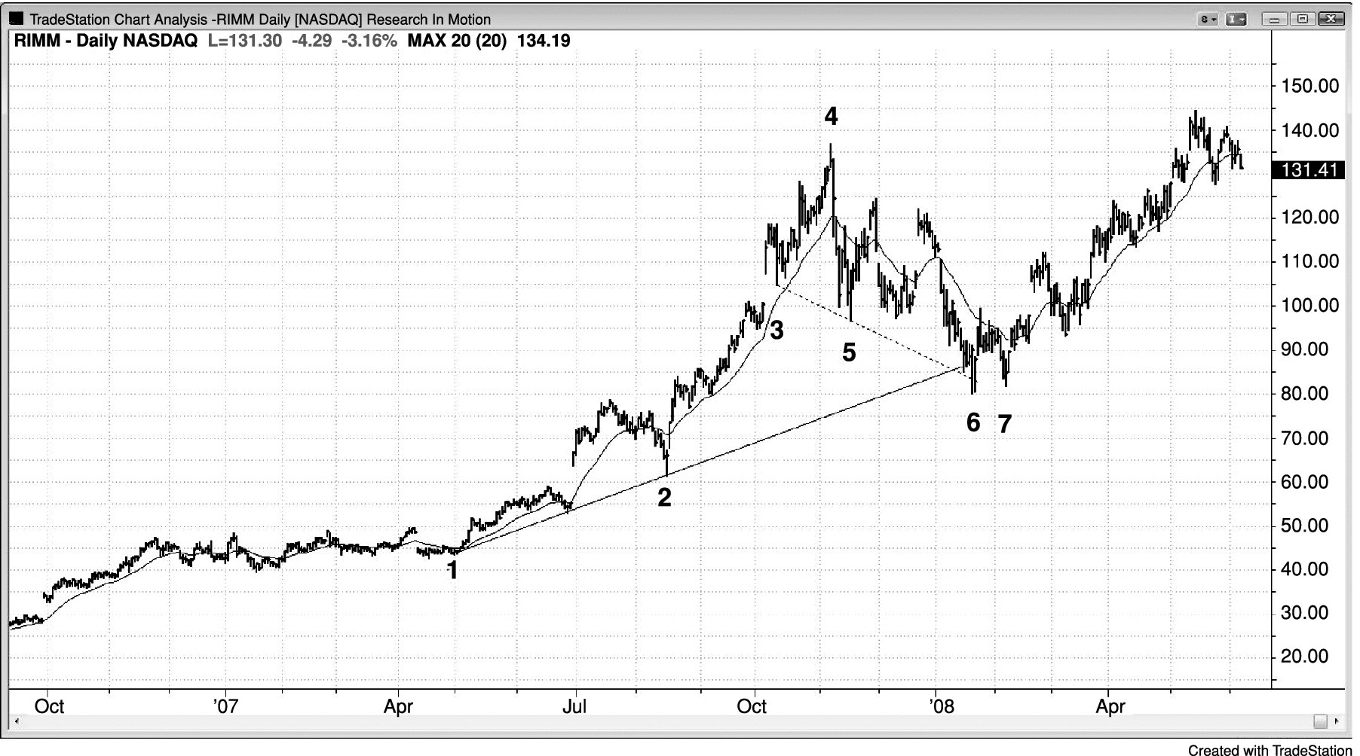
FIGURE 19.1 Dueling Lines Pullback

Slide 2
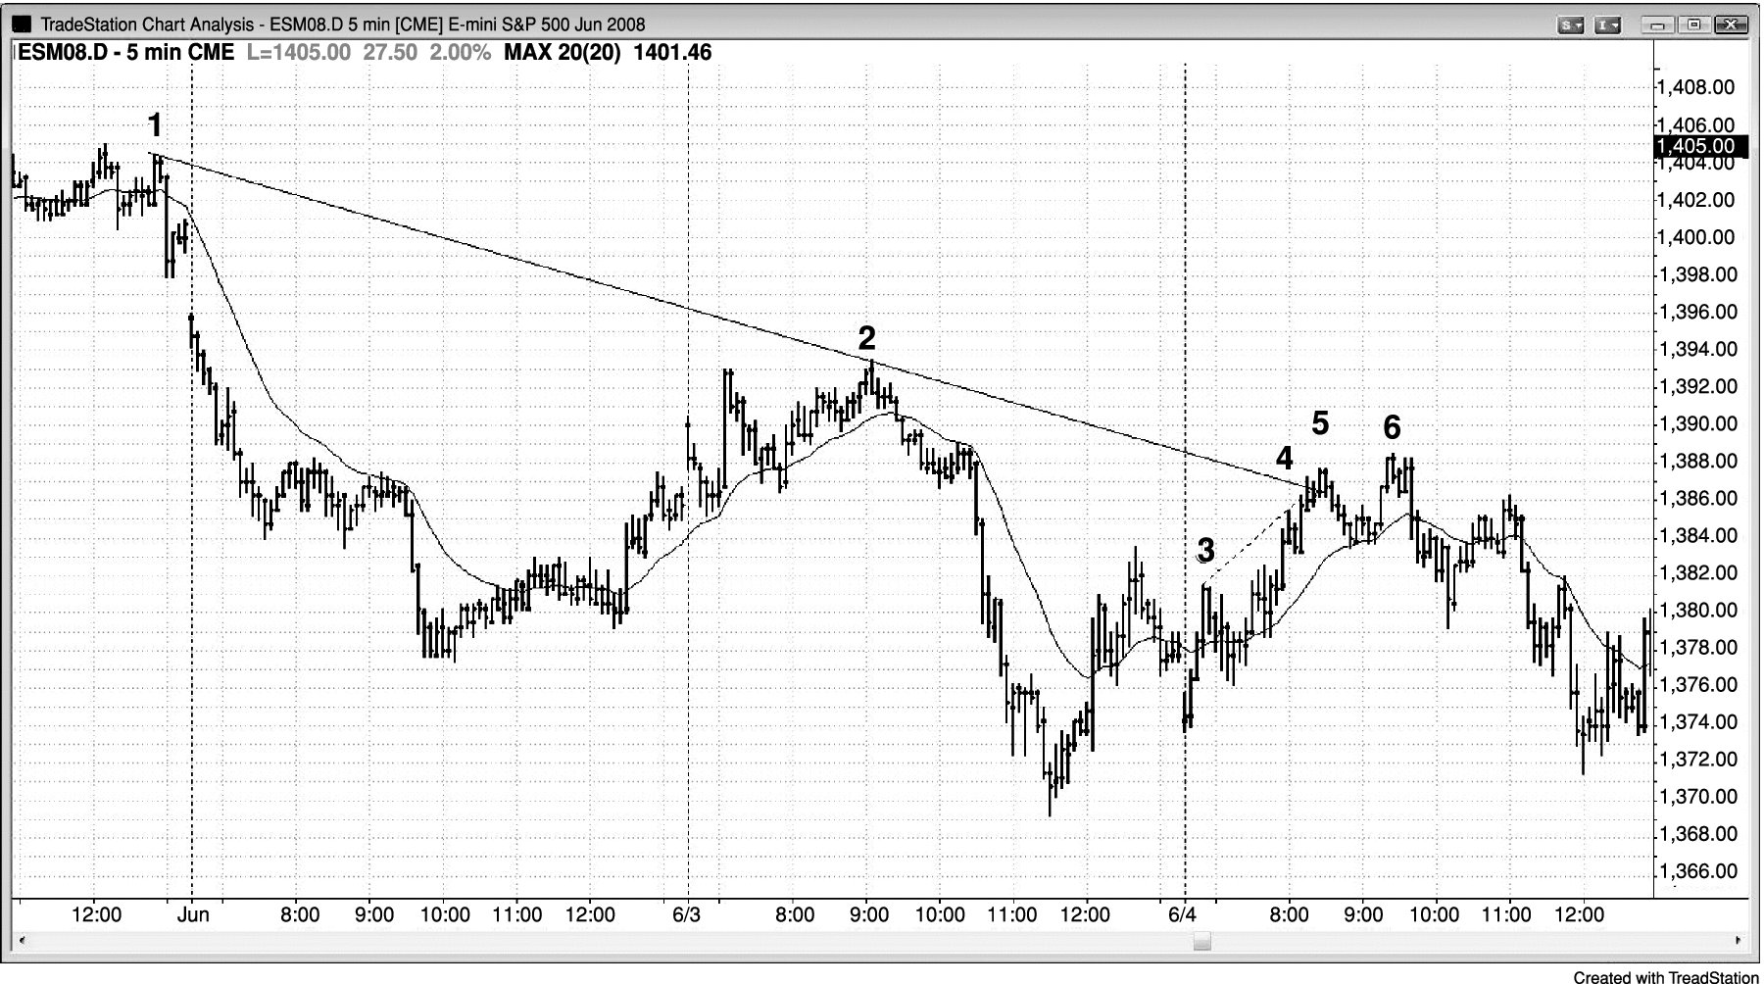
FIGURE 19.2 Dueling Lines

Slide 3
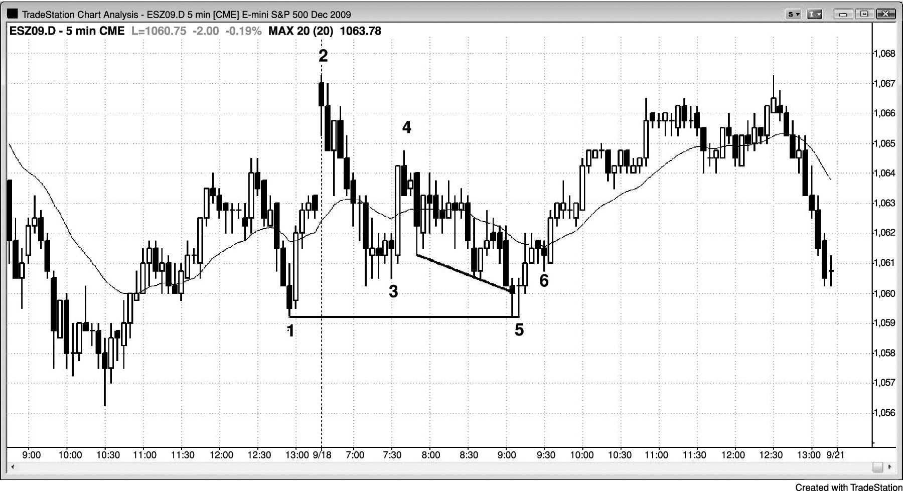
FIGURE 19.3 Dueling Lines Variant

